Slide 1


2nd International Summit on Human Genome Editing
Towards precise genome engineering in vivo
Xingxu Huang
ShanghaiTech University
Huangxx@shanghaitech.edu.cn

Slide 2
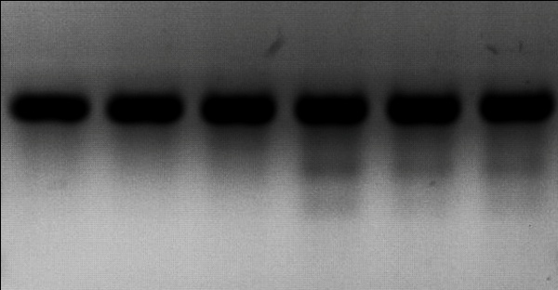
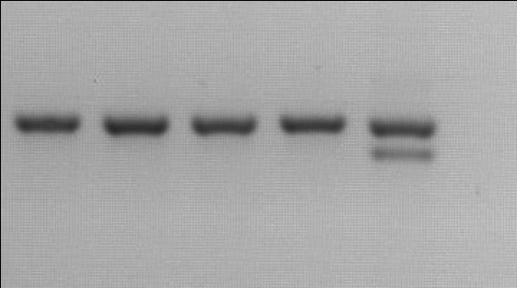
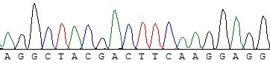
First in vivo CRISPR genome editing in mice
A
B
Cas9
-
+
-
+
+
+
ChiRNA
-
-
+
+
+
+
1
2
3
4
5
Ng
C
n=48
AGGCTACGTCCAGGAGCGCACCATCTTC:TTCAAGGACGACGGCAACTACAAGACC (WT)
AGGCTACGTCCAGGAGCGCACCATCTTCtTTCAAGGACGACGGCAACTACAAGACC (+1bp) AGGCTACGTCCAGGAGCGCACCATCTTCtTTCAAGGACGACGGCAACTACAAGACC (+1bp)
D
AGGCTACGTCCAGGAGCGCACCATCTTCTTCAAGGACGAC...AGGGCATCGACTTCAAGGAGG (WT)
AGGCTACG::::::::::::::::::::::::::::::::::::::::::::ACTTCAAGGAGG (-108bp)
Shen B, et al. Cell Res. 2013, 23(5): 720-723.

Slide 3
Successful in vivo genome editing in monkeys
AAAAAA…
Culture
8 ~ 10 h
Sperm injection
Cas9 mRNA/sgRNAs injection
Embryo transfer
Gestation
~ 5 months
Ppar-γ & Rag1
cynomolgus monkey
Mutant founders
Surrogate mother
Niu Y, et al. Cell 2014. 156(4): 836-843.

Slide 4
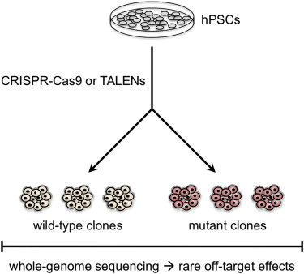
The off-target cleavage in individual clone
Kiskinis E, et al. Cell Stem Cell 2014.
Smith C, et al. Cell Stem Cell 2014.
Suzuki K, et al. Cell Stem Cell 2014.
Veres A, et al. Cell Stem Cell 2014.

Slide 5
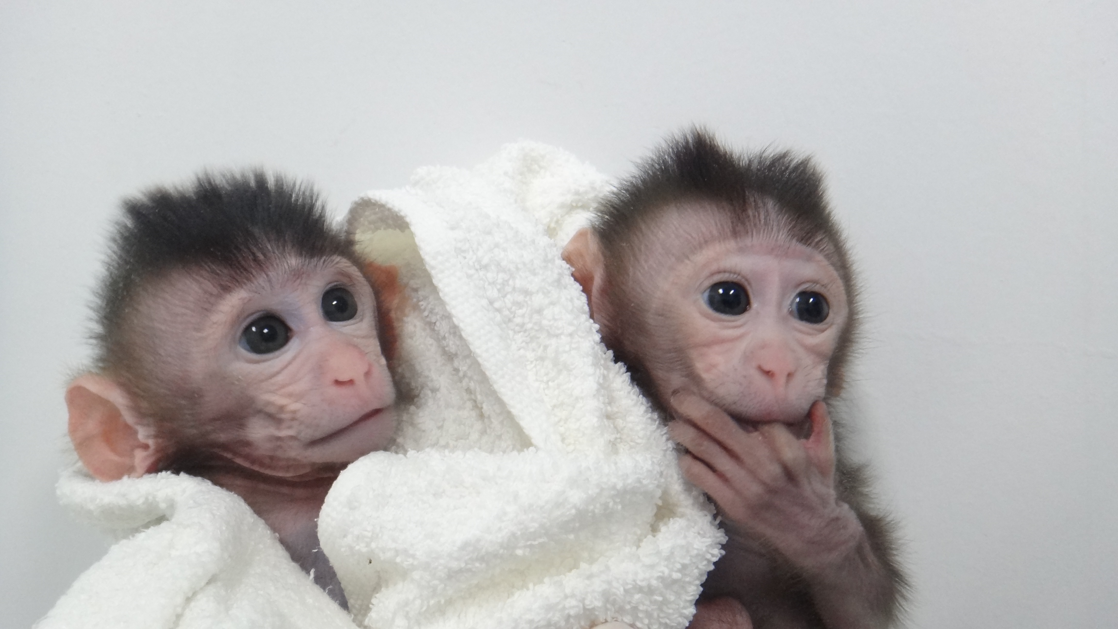
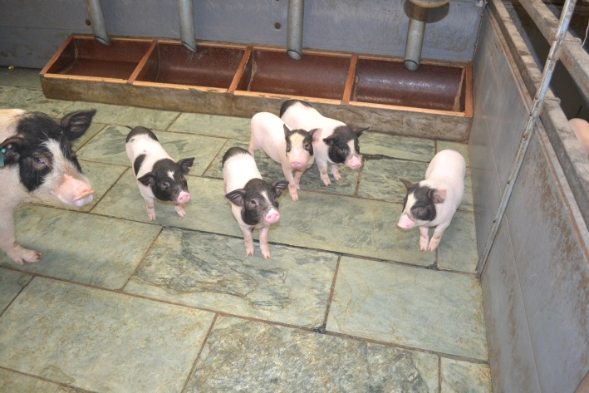
The off-target cleavage in vivo
Species | Number of sgRNA | Tentative off-target sites | Authentic off-target sites
Mouse | 7 | 97 | 9
Rat | 4 | 119 | 1
Pig | 1 | 8 | 0
Goat | 4 | 13 | 2
Monkey | 5 | 84 | 0
Notes:
5

Slide 6
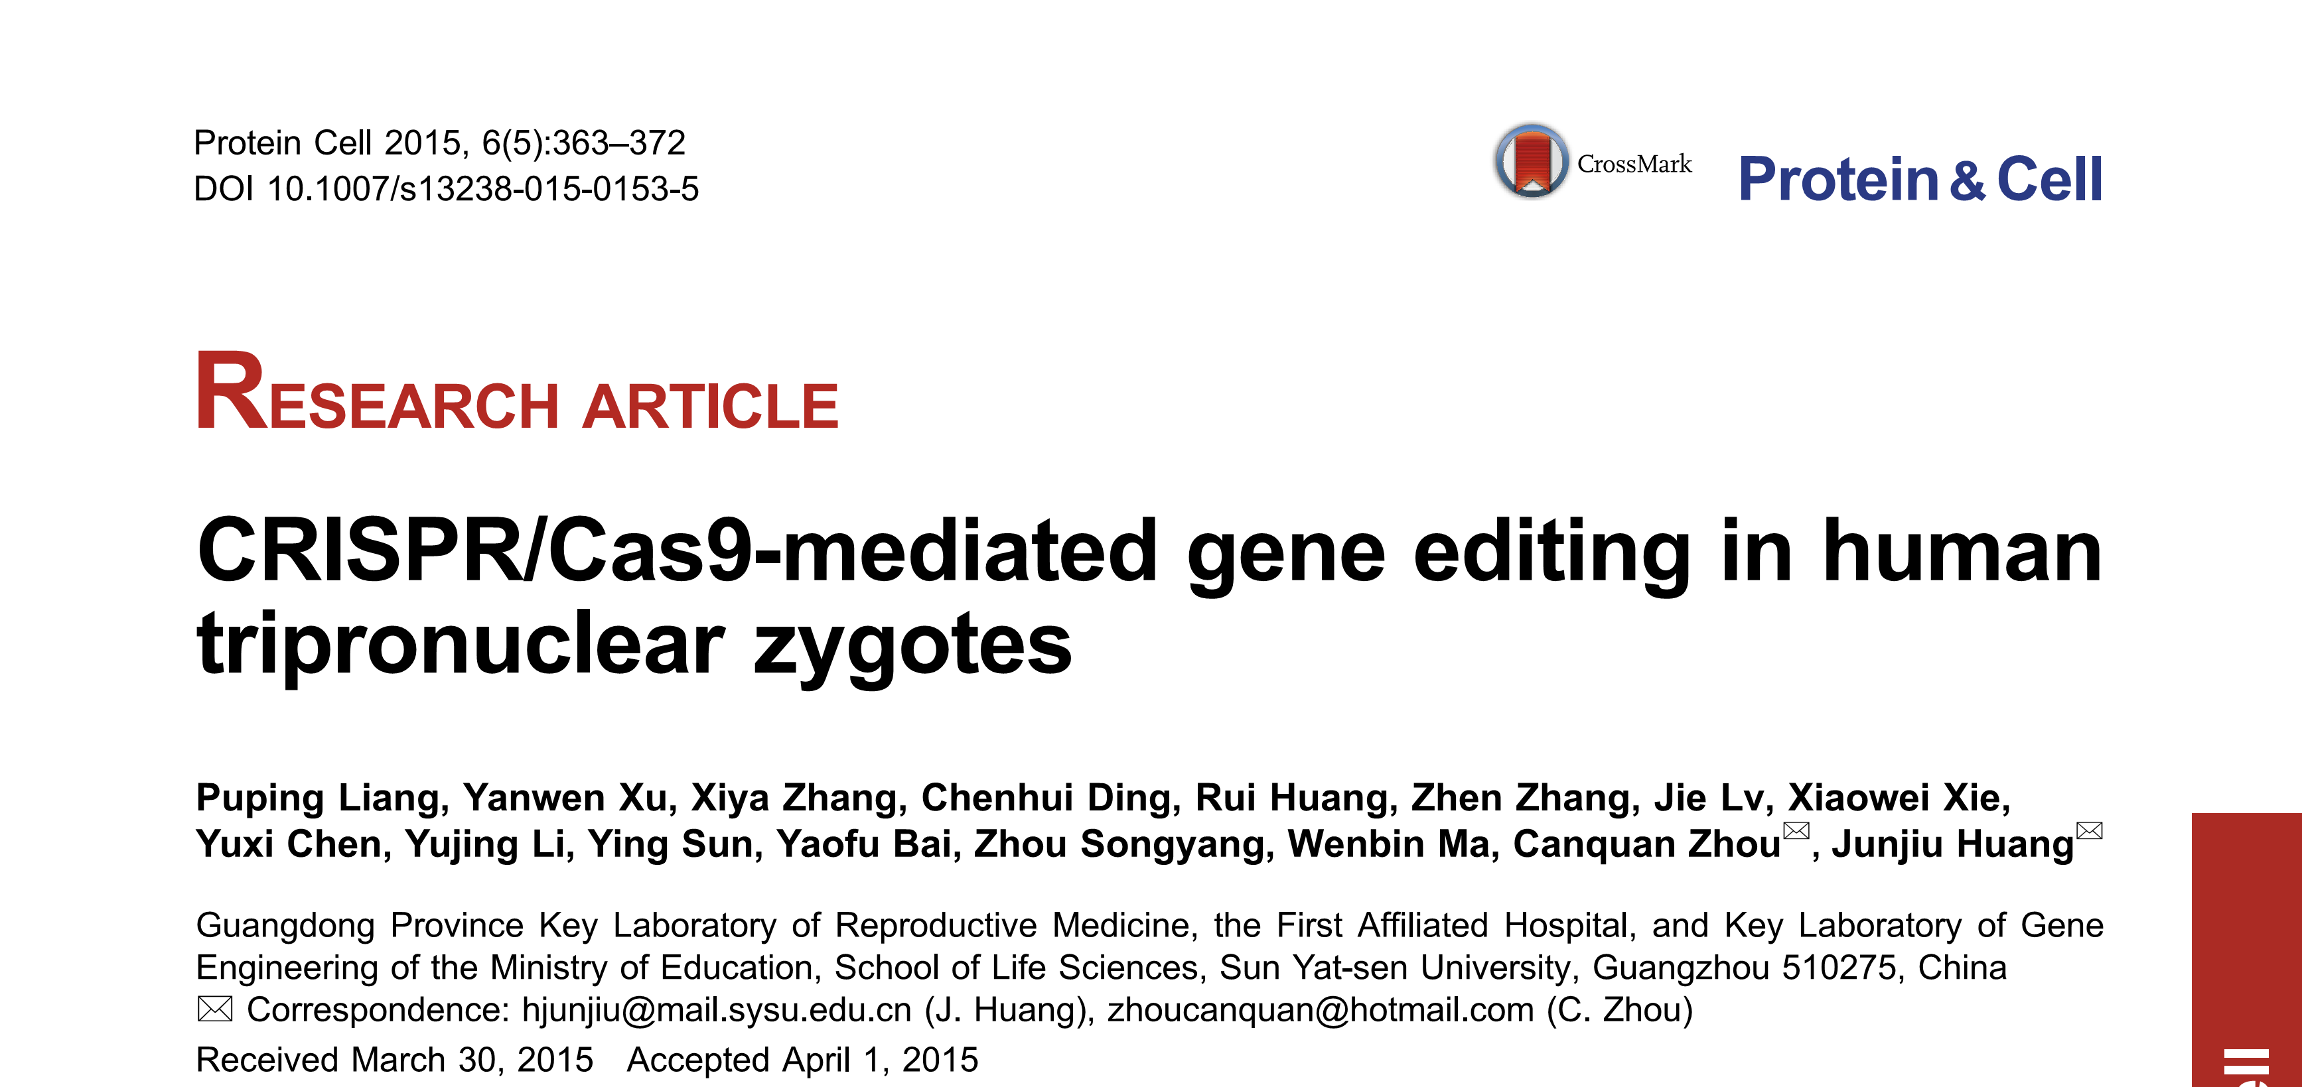
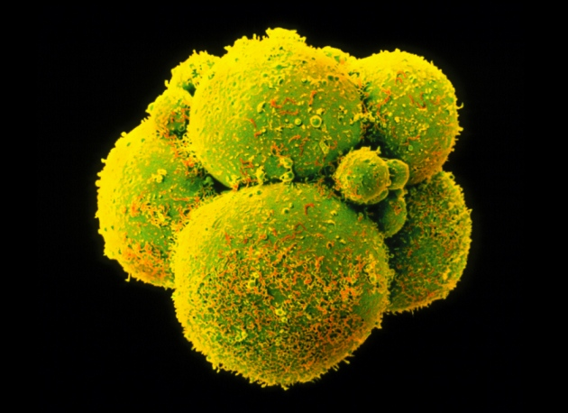
The human embryo editing
Concerns:
Efficacy
Safety
Mosaicism
http://www.nature.com/news/embryo-editing-sparks-epic-debate-1.17421
Notes:
6

Slide 7
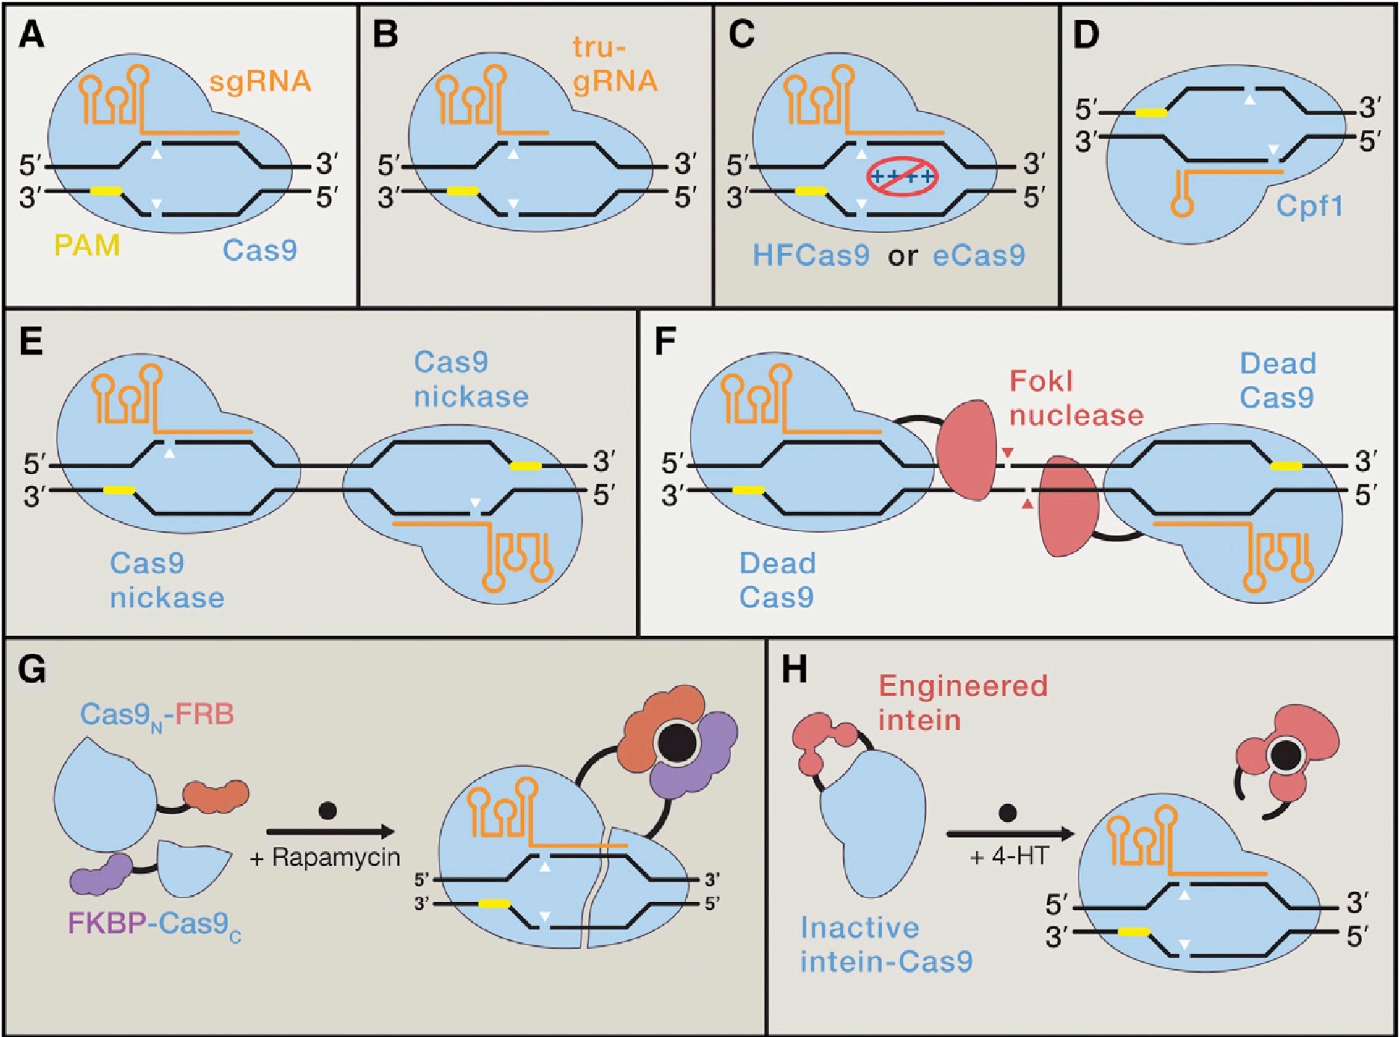
Strategies for improving the specificities
Komor A, et al. Cell 2017, 168: 20-36.

Slide 8
More CRISPR genome editing in human embryos
Kang et al. Introducing precise genetic modifications into human 3PN embryos by CRISPR/Cas-mediated genome editing. Journal Assisted Reproduction Genetics 2016, 33: 581-588.
Tang et al. CRISPR/Cas9-mediated gene editing in human zygotes using Cas9 protein. Molecular Genetics Genomics 2016, 292: 525-533.
Ma et al. Correction of a pathogenic gene mutation in human embryos. Nature 2017, 548: 413-419.
Fogarty et al. Genome editing reveals a role for OCT4 in human embryogenesis. Nature 2017, 550: 67-73.

Slide 9
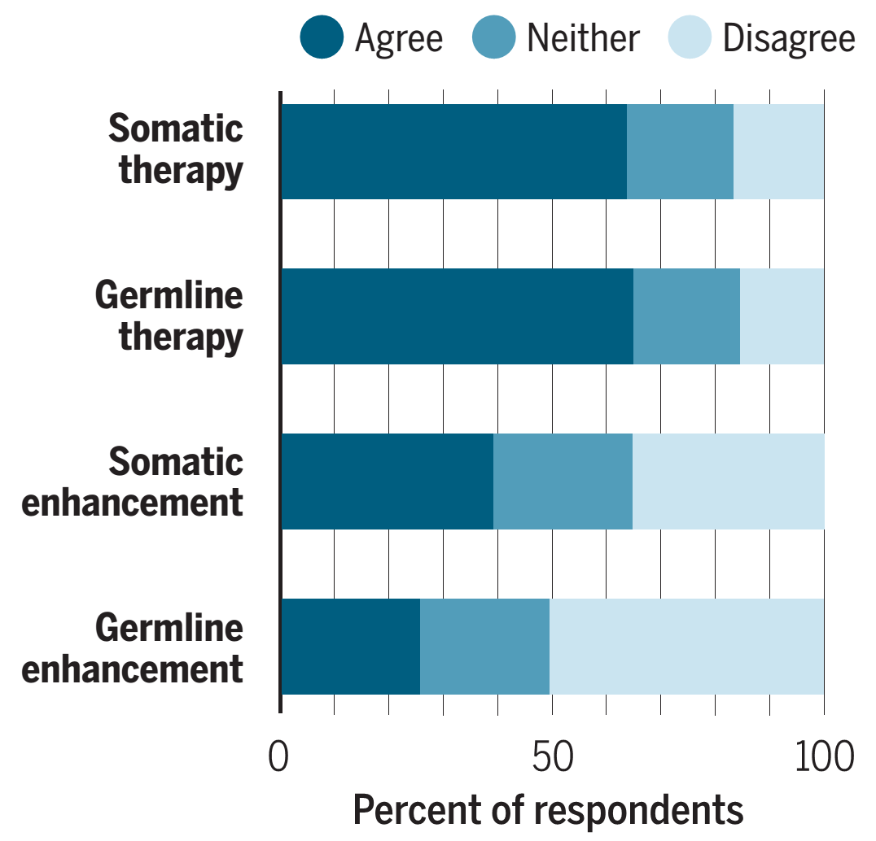
Attitudes on human genome editing
U.S. panel gives yellow light to embryo editing.
Feb. 14, 2017
http://www.sciencemag.org/news/2017/02/us-panel-gives-yellow-light-human-embryo-editing
Aug. 11, 2017
A majority finds use of human genome editing for therapeutic purposes acceptable, including somatic and germline edits. Public opposition increases for applications aimed at enhancement.
http://science.sciencemag.org/content/357/6351/553.full

Slide 10
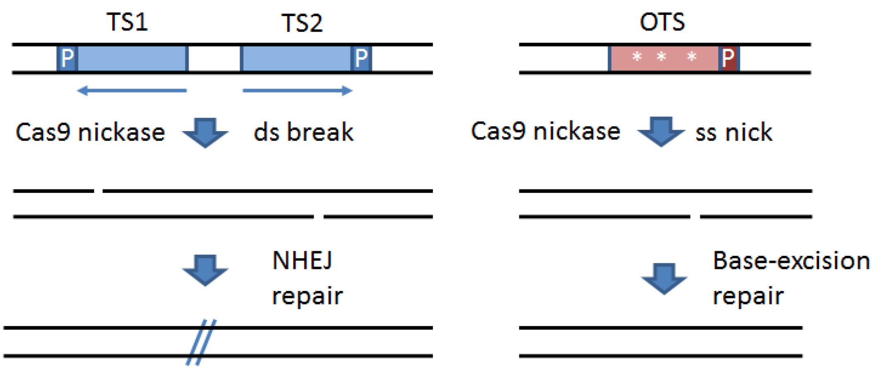
Minimizing off-target mutagenesis using Cas9-nickase/dual sgRNAs
http://www.sanger.ac.uk/htgt/wge/find_crisprs
Shen B, et al. Nature Methods 2014, 11(4): 399-402.

Slide 11
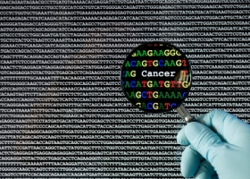
Off-target mutations are rare in vivo
http://www.bioworld.com/perspectives/
Iver V, et al. Nature Methods 2015, 12(6): 479.

Slide 12
nCas9/dual sgRNAs strategy reduces off-target
a
WT Cas9
D10A Cas9
3
4
6
7
14
21
110
111
112
113
WT
b
WT Cas9
D10A Cas9
3
4
6
7
14
21
110
111
112
113
WT
c
 | 20 | 19 | 18 | 17 | 16 | 15 | 14 | 13 | 12 | 11 | 10 | 9 | 8 | 7 | 6 | 5 | 4 | 3 | 2 | 1 | N | G | G
RAG1 sgRNAE | G | G | T | G | T | C | T | G | C | T | T | T | G | A | T | G | G | A | C | A | T | G | G
PP13 | T | A | T | G | T | C | T | G | C | A | T | T | G | A | T | G | G | A | C | A | A | G | G
PP13 CTTGGAGAAGGGGTCTTCTTTCCCCCCTTGTCCATCAATGCAGACATAGCTAGGGCTTCTCCTAAAGAAGCTC (WT)
#7 CTTGGAGAA------------------------------------------------------------GCTC (-60, 3/21)
Unpublished data

Slide 13
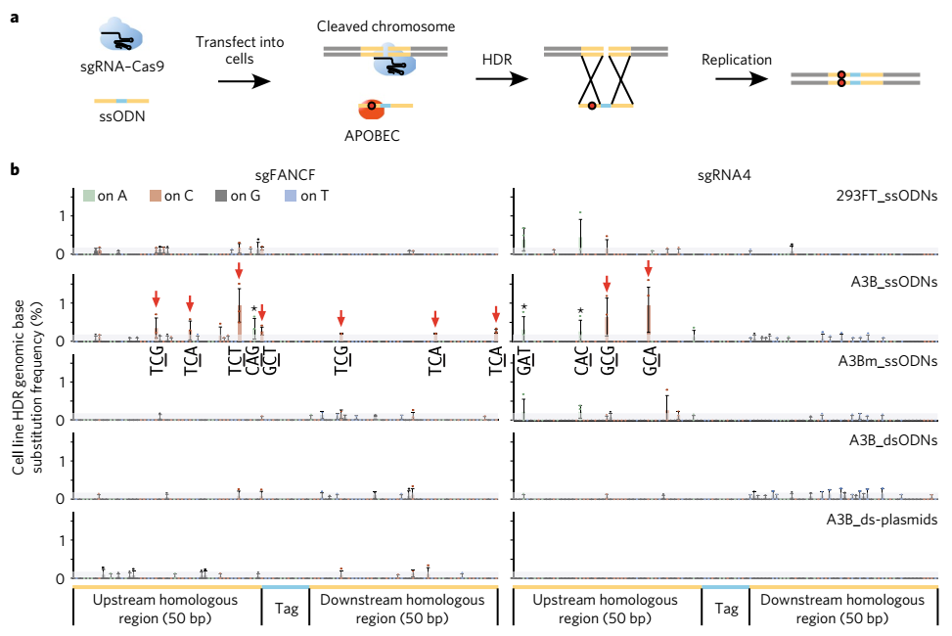
APOBEC3 mediates the formation of unexpected indel mutations near SSBs
Lei et al. NSMB 2018, 25: 45-52.

Slide 14
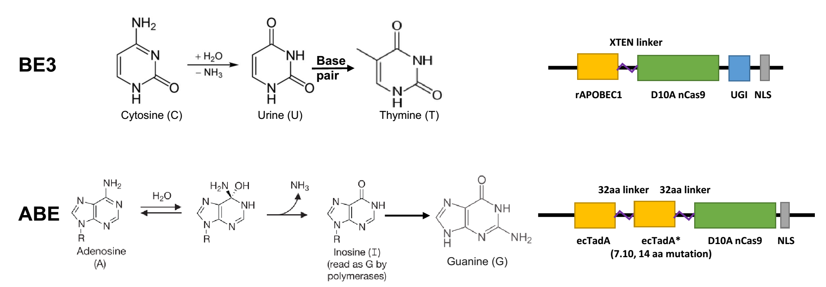
Base editing provides a more precise strategy
CBE: cytosine base editor
ABE: adenine base editor
Perform programmable editing of a target base in genome by deamination without double-stranded DNA cleavage.
Komor et al. Nature 2016; Gaudelli et al. Nature 2017

Slide 15
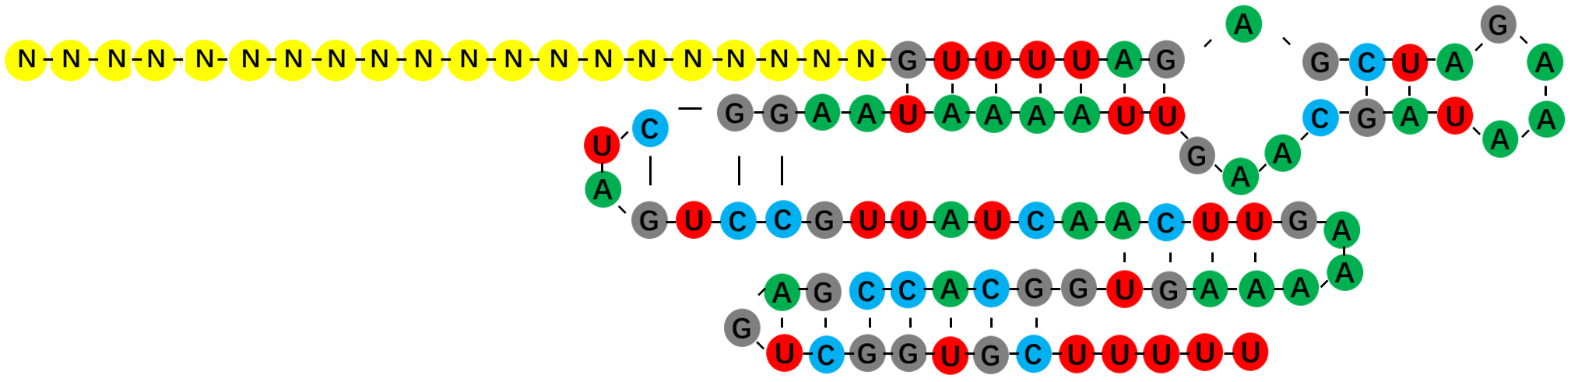
To develop in vivo base editing toolbox
APOBEC
/TadA
5’
UGI
3’
nCas9
3’
5’
sgRNA

Slide 16
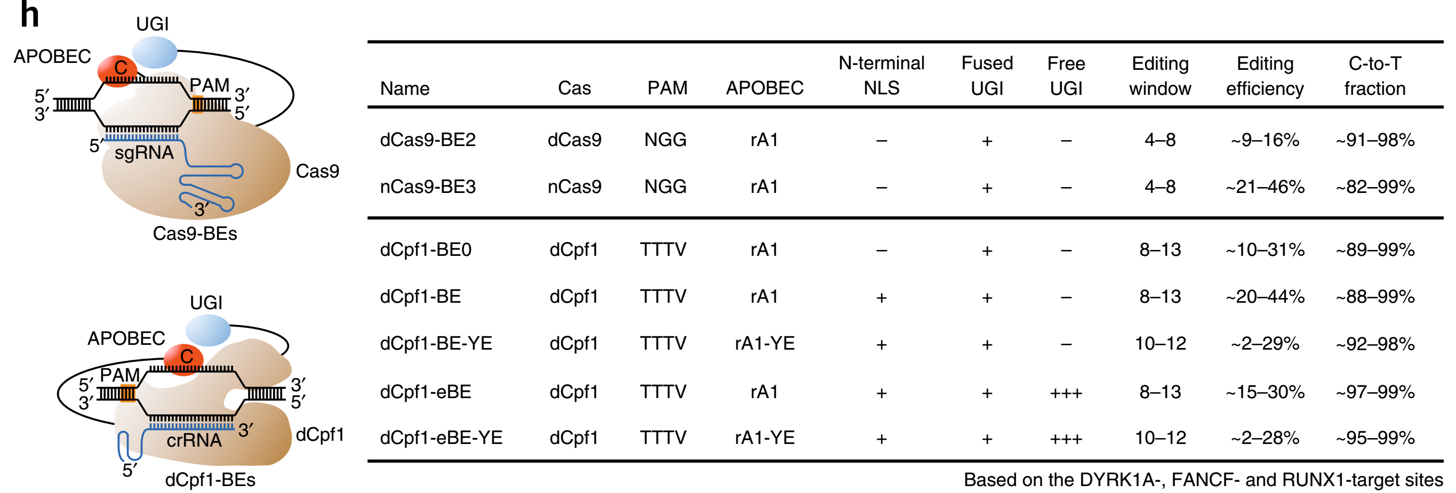
High-fidelity C/T base editing mediated by Cpf1-cytidine deaminase fusion
Li et al. Nature Biotechnol. 2018, 36(4): 324-327.

Slide 17
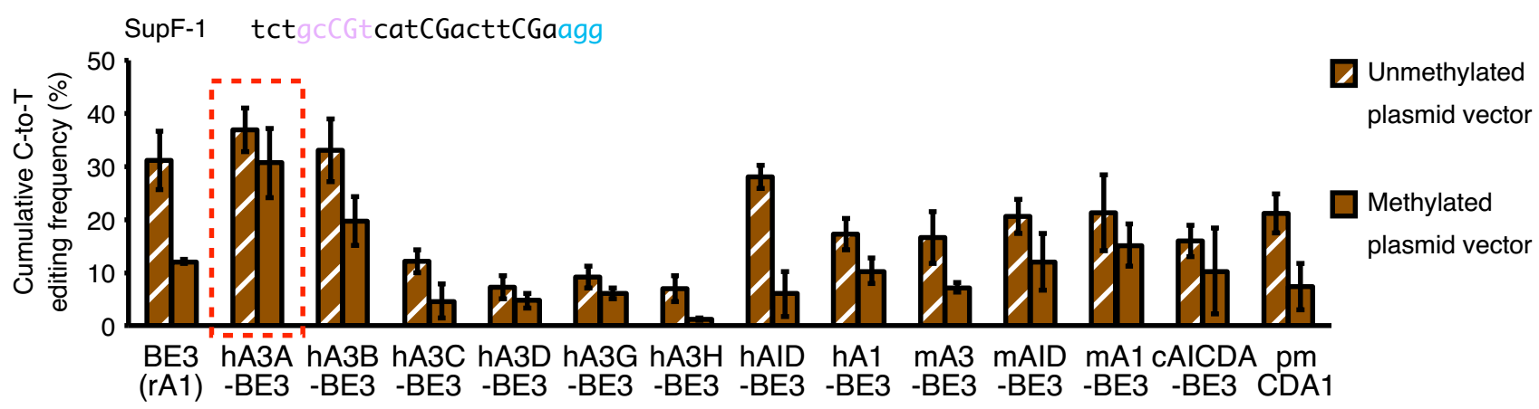
Comprehensive C/T base editing mediated by a new deaminase, A3A
Wang et al. Nature Biotechnol. 2018, 36(10): 946-949.

Slide 18
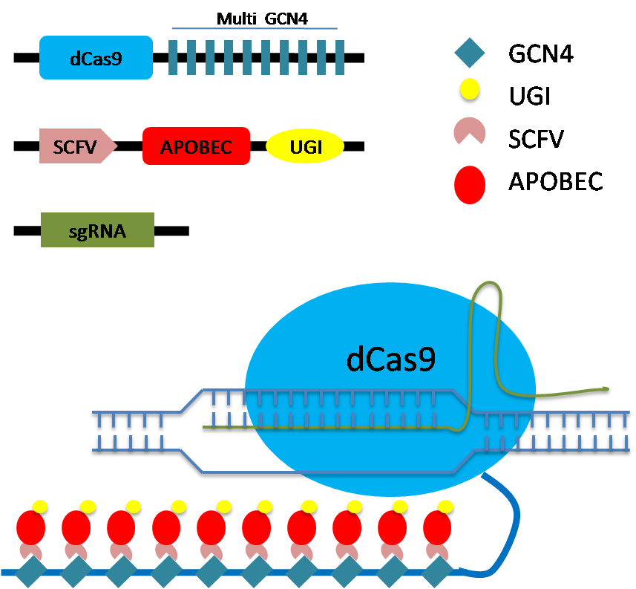
BE-PLUS, to increase the editing scope & precision
A
B
C
Jiang et al. Cell Res. 2018, 28(8): 855-861.

Slide 19
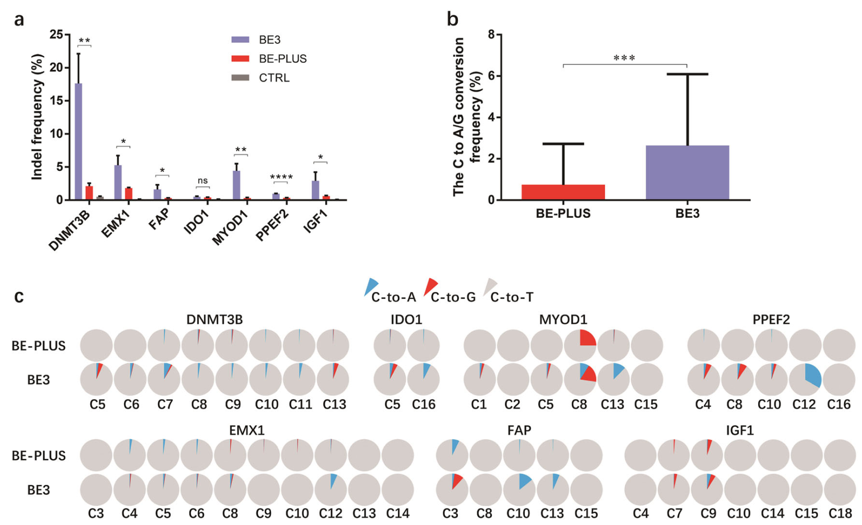
BE-PLUS enhances the fidelity of C/T base editing
Jiang et al. Cell Res. 2018, 28(8): 855-861.

Slide 20
BE3 mediates isogenic C/T gene editing in vivo
a
CAG(Gln)➔TAG(STOP)
APOBEC
5’
UGI
3’
CAA(Gln)➔TAA(STOP)
nCas9
3’
5’
CGA(Arg)➔TGA(STOP)
sgRNA
TGG(Trp)➔TGA/TAG/TAA(STOP)
b
VISTA sp-1
CAGCACCACGGAAGCCACCTGAAAGCCAACGCCAGCCATGACC₆AGCCCCAGAAGCATGGGCTAGAGCTAGCTTCTGAC (WT)
CAGCACCACGGAAGCCACCTGAAAGCCAACGCCAGCCATGATT₆AGCCCCAGAAGCATGGGCTAGAGCTAGCTTCTGAC (14/16,6/14 homozygote)
CAGCACCACGGAAGCCACCTGAAAGCCAACGCCAGCCATGACT₆AGCCCCAGAAGCATGGGCTAGAGCTAGCTTCTGAC (1/16,0/1 homozygote)
CAGCACCACGGAAGCCACCTGAAAGCCAACGCCAGCCATGATC₆AGCCCCAGAAGCATGGGCTAGAGCTAGCTTCTGAC (1/16,0/1 homozygote)
CD160 sp-2
AGCATCCCAGAAAGGAGGGCGACTGGACCTCACCTGTACTTTGTG₆G₅CACAAGAAAGACGAAGCTGAGGGGCTAATACT (WT)
AGCATCCCAGAAAGGAGGGCGACTGGACCTCACCTGTACTTTGTA₆G₅CACAAGAAAGACGAAGCTGAGGGGCTAATACT (3/12,2/3 homozygote)
AGCATCCCAGAAAGGAGGGCGACTGGACCTCACCTGTACTTTGTA₆A₅CACAAGAAAGACGAAGCTGAGGGGCTAATACT (2/12,0/2 homozygote)
Table 1 Summary of the microinjections
Target genes | Methods |  | No. of examined embryos | No. of two-cell stage embryos (%) | No. of blastocysts (%) | Mutant ratio (%)
 |  |  |  |  |  | No. of mutants/total blastocysts | No. of homozygotes/total mutants
VISTA | VSITA mRNA+BE3 mRNA | Microinjection | 20 | 18 (90)ª | 16 (89)^{b} | 16 (100) | 6/16 (38)
CD160 | CD160 mRNA+BE3 mRNA | Microinjection | 20 | 17 (85)ª | 12 (71)^{b} | 9 (75) | 2/9 (22)
Manuscript accepted

Slide 21
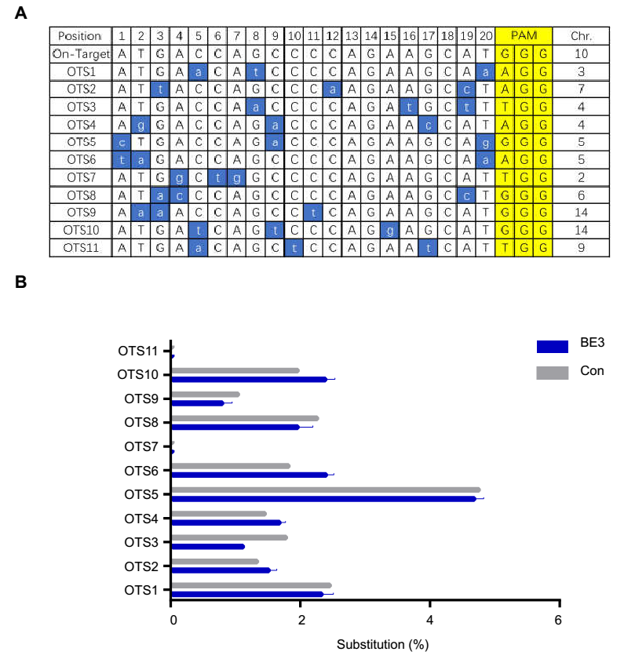
Off-target analysis by deep sequencing
Manuscript accepted

Slide 22
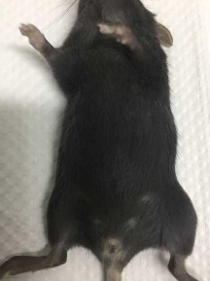
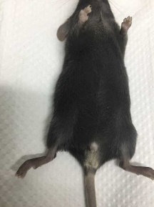
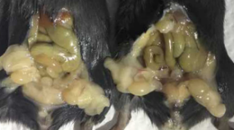
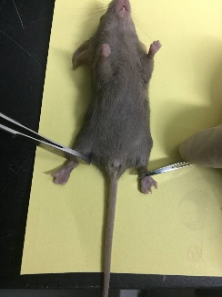
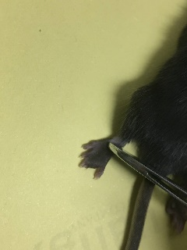
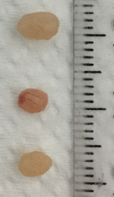
ABE mediates efficient A/G base editing in vivo
a
b
100
100
Editing efficiency(%)
Editing efficiency(%)
50
50
0
0
A3
A7
C5
A6
A8
A9
sgAr-1
sgAr-15
sgHoxd13
c
sgAr-1
sgAr-1
sgHoxd13
d
Guanine
Adenine
WT TTATCTAGCCTCAATGAGCTTGG
A011 TTGTCTGGCCTCAATGAGCTTGG 14/14 (L681L,S683G)
sgAr-15
Deep sequencing
ABE
WT CCTGAAATGATGGCAGAGATCAT
A054 CCTGAAATGATGGCAGAGACCAT 12/12 (I878T)
WT
sgHoxd13
A3
A7
A4
A6
WT GTTTCAGAATCGAAGGGTGAAGG
H029 GTTTCGGAATCGAAGGGTGAAGG 12/12 (Q321R)
sgAr-1
sgAr-15
sgHoxd13
e
A021
wt male
A021
wt male
f
H029
H020
Liu et al. Nature Commun. 2018, 9(1): 2338.

Slide 23
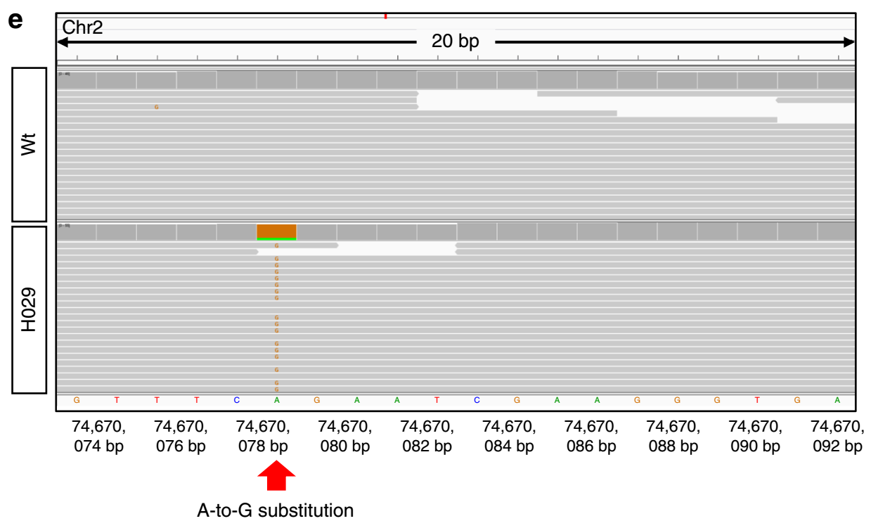
On-target and off-target analysis
Liu et al. Nature Commun. 2018, 9(1): 2338.

Slide 24
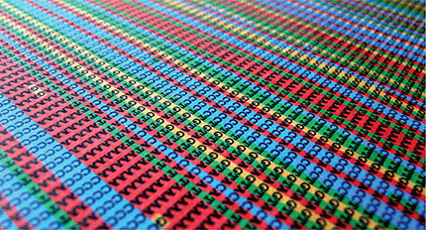
A safe & efficient in vivo genome editing approach
BE: pinpoint gene editing
http://vis.sciencemag.org/breakthrough2017/

Slide 25
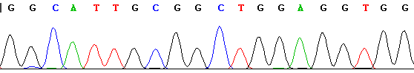
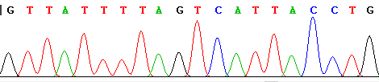
Efficient & pure in vivo C/T conversion by BE
a
c
#1
#11
b
d
GCGCCCCGGTGGCACTGCGGCTGGAGGTGGGGGTTAAAGC (wt)
CCCCTTGGCAGTCATCTTAGTCATTACCTGAGGTGTTCGT (wt)
GCGCCCCGGTGGCACTGCGGCTGGAGGTGGGGGTTAAAGC (wt, 1/8)
GCGCCCCGGTGGCATTGCGGCTGGAGGTGGGGGTTAAAGC (mt, 7/8)
CCCCTTGGCAGTCATCTTAGTCATTACCTGAGGTGTTCGT (wt, 1/8)
CCCCTTGGCAGTTATTTTAGTCATTACCTGAGGTGTTCGT (mt, 7/8)
Table 1 Summary of the microinjections
 | Injected mixture | Target sites | No. of examined tripronuclear zygotes | No. of mutants/total zygotes | Editing efficiency
Experiment 1 | mRNA+sgRNA | SITE 4 | 8 | 7/8 | 87.5%
Experiment 2 | mRNA+sgRNA | RNF2 | 8 | 7/8 | 87.5%
Experiment 3 | mRNA+sgRNA | SITE4 | 9 | 9/9 | 100%
 |  | RNF2 | 9 | 9/9 | 100%
Li G, et al. Protein & Cell 2017, 8(10): 776-779.

Slide 26
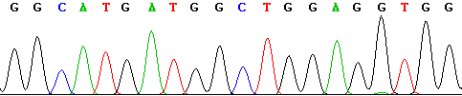
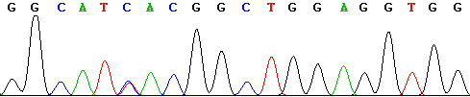
With very rare off-target
a
 | 20 | 19 | 18 | 17 | 16 | 15 | 14 | 13 | 12 | 11 | 10 | 9 | 8 | 7 | 6 | 5 | 4 | 3 | 2 | 1 | N | G | G
SITE4 | G | G | C | A | C | T | G | C | G | G | C | T | G | G | A | G | G | T | G | G | G | G | G
OTS3 | G | G | C | A | C | G | A | C | G | G | C | T | G | G | A | G | G | T | G | G | A | G | G
OTS4 | G | G | C | A | T | C | A | C | G | G | C | T | G | G | A | G | G | T | G | G | A | G | G
b
Off-target-3
c
Off-target-4
d
Off-target-3
 | G | G | C | A | C | G | A | C | G | G | C | T | G | G | A | G | G | T | G | G | G | G | G
#2 |  |  | 0.00 |  | 0.01 |  |  | 0.00 |  |  | 0.00
#3 |  |  | 0.00 |  | 0.76 |  |  | 0.67 |  |  | 0.00
#18 |  |  | 0.00 |  | 0.18 |  |  | 0.01 |  |  | 0.00
e
Off-target-4
 | G | G | C | A | T | C | A | C | G | G | C | T | G | G | A | G | G | T | G | G | A | G | G
#2 |  |  | 0.00 |  |  | 0.00 |  | 0.02 |  |  | 0.00
#3 |  |  | 0.00 |  |  | 0.36 |  | 0.00 |  |  | 0.00
#18 |  |  | 0.00 |  |  | 0.01 |  | 0.00 |  |  | 0.00
Li G, et al. Protein & Cell 2017, 8(10): 776-779.

Slide 27
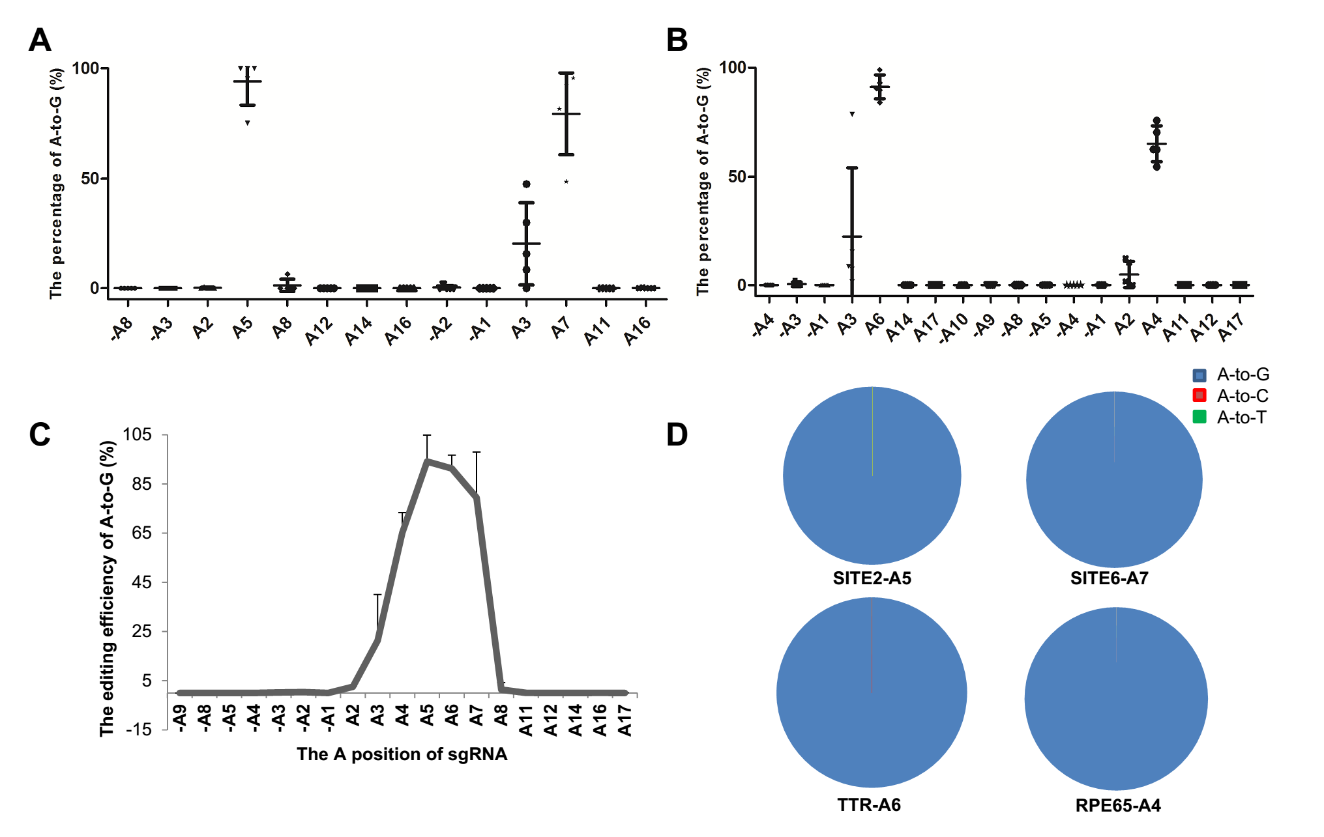
Efficient & pure in vivo A/G conversion by ABE
Manuscript under review

Slide 28
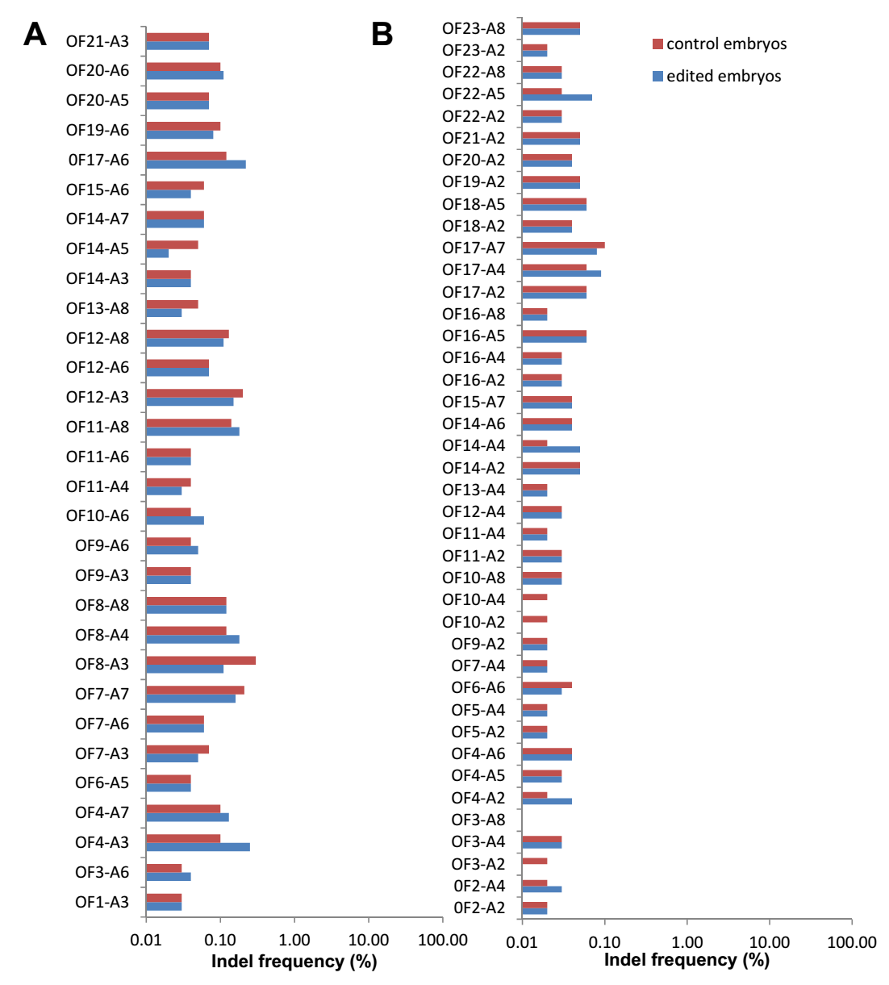
No off-target was detected
Manuscript under review

Slide 29
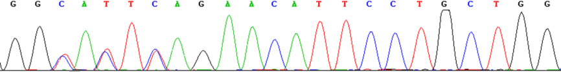
BE mediates isogenic genome editing in vivo
a
BE3-mRNA+
sgRNA
Collection
&
Detection
1
2 days
Tripronuclear embryos
BE3-mRNA+
sgRNA
2
Collection
&
Detection
2 days
…
Tripronuclear embryos
Individual blastomere
b
GATAD2A (Chr. 19)
E4
E5
CCCGCTTGTTCGGGGCACTCAGAACATTCCTGCTGGCAAGCCATCAC
Unpublished data

Slide 30
To correct pathogenic mutation of genetic disease
There are an estimated 6,000~8,000 rare diseases. The rare diseases are estimated to collectively affect more than 200 million people worldwide;
Three-quarters affect children, over half are life limiting;
Over 80% of rare diseases are genetic in origin. Most are caused by defects in a single gene;
Both the central nervous system (CNS), and peripheral organs and tissues are affected in most rare diseases;
There are treatments for only 6% of rare diseases, of which fewer than 1% are curative;
It was too expensive, at an average of $1 million per treatment.
Orkin & Reilly. Science 2016, 352: 1059-1061.
Melnikova. Nat Rev Drug Dis. 2012, 11: 267-268.
Boycott & Ardgo. Nat Rev Drug Dis. 2018, 17: 151-153.

Slide 31
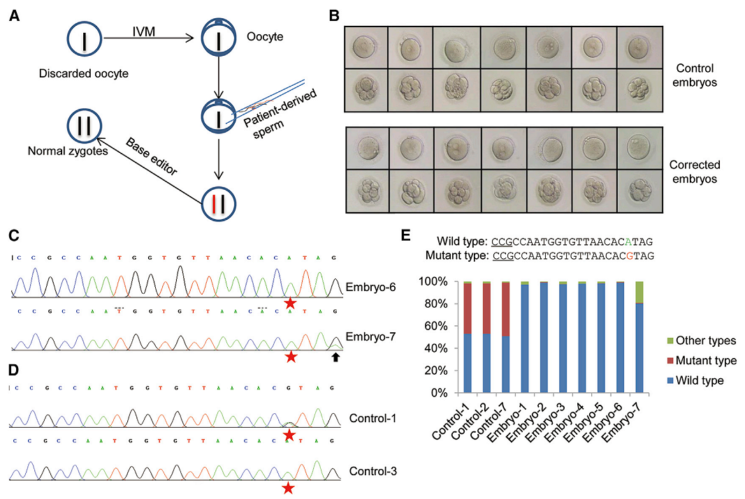
Correction of the MFS pathogenic FBN1^{T7498C} mutation by BE in tripronuclear human embryos
Zeng et al. Mol Ther. 2018, 26(11): 2631-2637.

Slide 32
No off-target
A
B
Off-target-1
Off-target-2
Off-target-3
Off-target-4
Off-target-5
Off-target-6
Off-target-7
Off-target-8
Off-target-1
Off-target-2
Off-target-3
Off-target-4
Off-target-5
Off-target-6
Off-target-7
Off-target-8
Zeng et al. Mol Ther. 2018, 26(11): 2631-2637.

Slide 33

BE: a precise strategy for correction of pathogenic mutations in a appropriate way
Ethically: strict regulation （“really the last reasonable option”）
Technically: efficacy, safety, mosaicism
Translational cooperation
… …
Pei et al. Cell Stem Cell 2017, 21: 423-426.
http://www.sciencemag.org/news/2017/02/us-panel-gives-yellow-light-human-embryo-editing
Easy to develop correction for rare genetic disease pathogenic mutations;
Once intervention with good effect;
Low cost.
Notes:
33

Slide 34
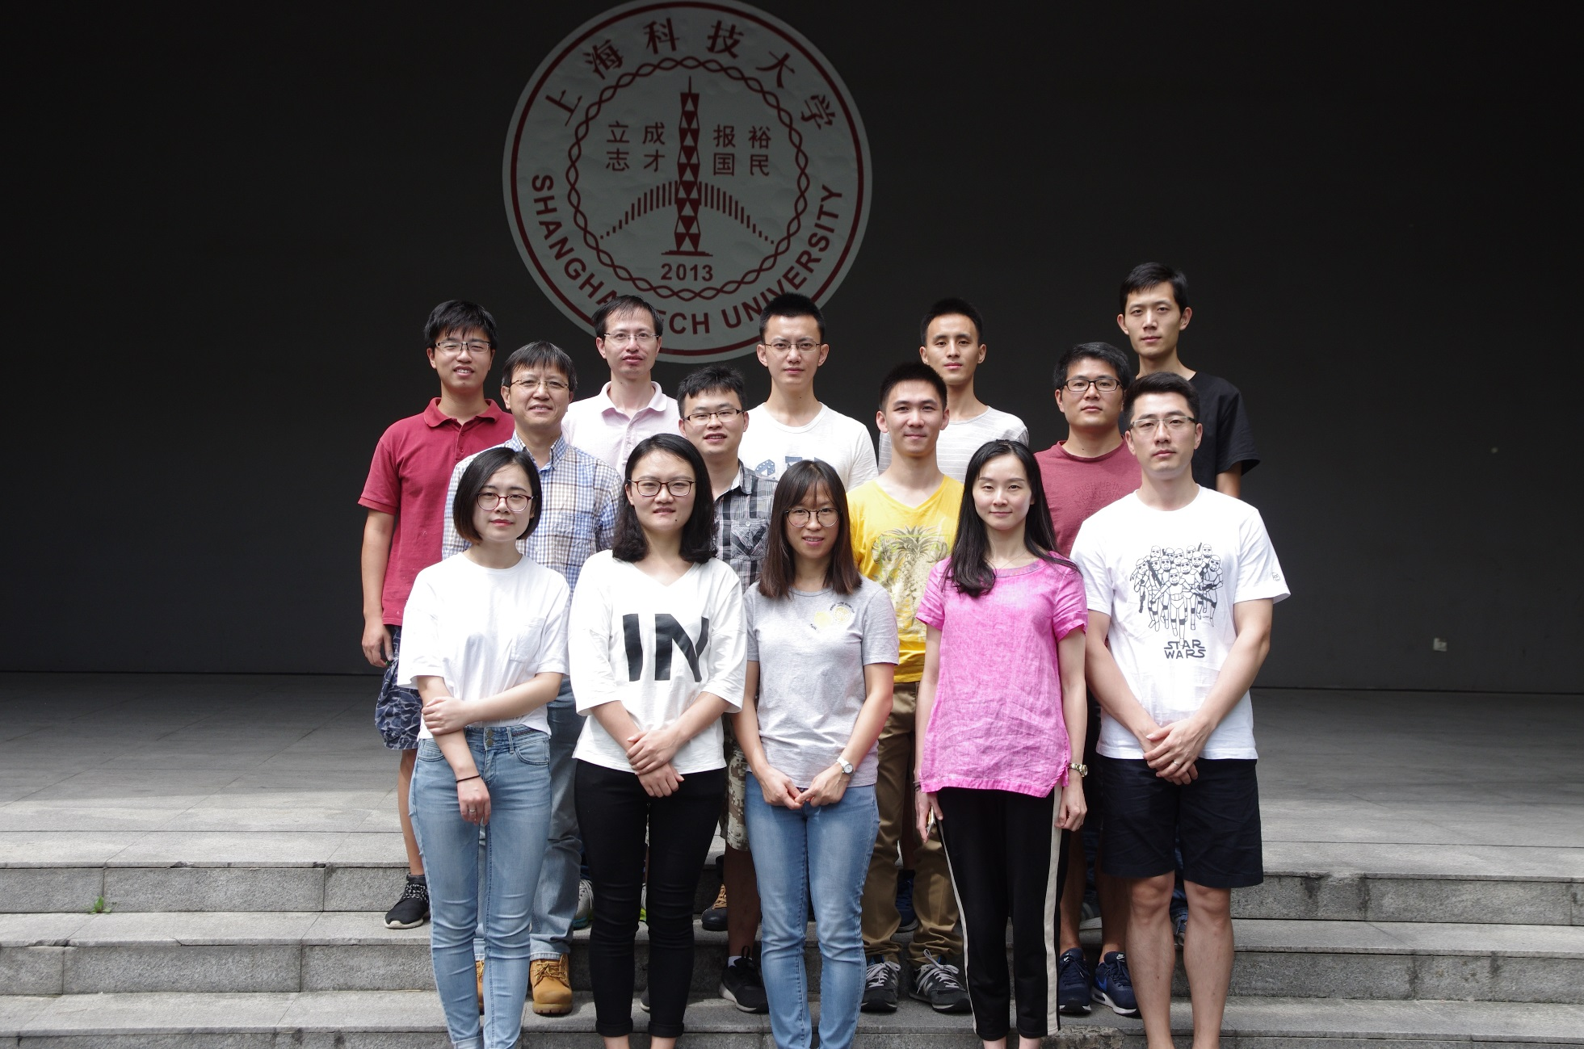
Acknowledgements

Slide 35
Acknowledgements
南京医科大学
沙家豪 郭雪江 实验室
云南省灵长类生物医学重点实验室
季维智 牛昱宇 陈永昌 实验室
中科院动物研究所
周 琪 实验室
Wellcome Trust Sanger Institute
Dr. William Skarnes
中国医科院实验动物研究所
张连峰 马元武 实验室
广州医科大学附属第三医院
刘见桥 实验室
南京大学鼓楼医院
孙海翔 颜桂军 实验室
西北农林科技大学
陈玉林 马宝华 实验室
上海科技大学
陈 佳 实验室
中科院计算生物学所
杨 力 实验室
西南医院
陈洁平 实验室
中科院神经科学研究所
孙 强 刘 真 实验室
基金委（30871429、31171377、31471400、81671516）
科技部（2009CB918703、2010CB945101、2011CB944301、2016YFA0500903、2016YFC0905901）

Slide 36

THANK YOU

